Slide 1

Wound Infections
The Basics

Slide 2
Overview
Wound Infection Continuum
Biofilm
Assessment: NERDS & STONEES
Management

Slide 3
Wound Infection Continuum
Contamination
Colonization
Local Infection
Spreading Infection
Systemic Infection

Slide 4
Contamination
Presence of non-proliferating microbes within a wound at a level that does not evoke a host response
All wounds are contaminated due to bacterial presence on the skin
Host responses respond and destroy via phagocytosis

Slide 5
Colonization
Presence of microbial organisms in the wound that undergo limited proliferation without evoking a host response
Microbial growth to a non-critical level
Wound healing not impeded or delayed

Slide 6
Local Infection
Bacteria or microbes move deeper into the wound and proliferate at a rate that evokes a response
Contained to one location, system, or structure
Erythema, local warmth, swelling, purulent discharge, delayed healing, increasing or new pain, increasing malodour
Subtle signs: hypergranulation, bleeding, epithelial bridging and pocketing, breakdown

Slide 7
Spreading Infection
Invasion of the surrounding tissue by infective organisms that have spread from the wound.
Signs and symptoms spread beyond the wound border
Extending in duration +/- erythema, lymphangitis, crepitus, wound breakdown +/- satellite lesions, malaise, loss of appetite, inflammation, swelling of lymph glands

Slide 8
Systemic Infection
Microbes spreading throughout he body via vascular or lymphatic system
Systemic inflammatory response, sepsis, organ dysfunction

Slide 9
Biofilm
Not typically visible
Criteria indicative of biofilm: Failure of appropriate antibiotics, recalcitrance to appropriate antimicrobial, recurrence of delayed healing on cessation of antibiotics, delayed healing despite optimal wound management and health support, increased exudate/moisture, low-level chronic inflammation, low-level erythema, poor granulation/friable hypergranulation, secondary signs of infection

Slide 10
Assessment
Healthy individuals with acute wounds present with OVERT or CLASSIC signs and symptoms of infection
Immunocompromised and those with chronic wounds: SUBTLE or COVERT
Friable, bright red granulation tissue
Increasing malodour
New or increasing pain or change in sensation
Epithelial bridging and pocketing in granulation tissue
Delayed wound healing beyond expectations
Wound breakdown/enlargement or new ulcerations in periwound

Slide 11
NERDS (local infection)
Non-Healing: wounds that are not 20-40% smaller in 4 weeks according to patient history or existing documentation
Exudative Wound: Increase in wound exudate can be indicative of bacterial pro-inflammatory damage and leads to periwound maceration. More than 50% of the dressing stained with exudate
Red and Bleeding Wound: wound bed tissue is bright red with exuberant granulation tissue. Tissue bleeds easily with gentle manipulation
Debris: presence of discoloured granulation tissue, slough, and necrotic tissue
Smell from the wound: unpleasant or sweet, sickening odour

Slide 12
STONEES (Spreading Infection)
Size is bigger: wound increasing in size
Temperature increased: increased periwound margin temperature by more than 3°F difference between two mirror image sites
Os (probes to or exposed bone): wounds that have exposed bone or that probed to bone at he time of examination
New areas of breakdown: new areas of breakdown or satellite lesions
Eyrthema/Edema: reddened skin in periwound area, presence of swelling in periwound area
Exudate: increased amount of drainage
Smell: unpleasant or sweet, sickening odour

Slide 13
Validation
Combining three signs
Wounds with elevated temperature were 8x more likely to have moderate to heavy bacterial growth
Sensitivity for scant to light bacterial growth | Sensitivity for moderate to heavy bacterial growth
73.3% | 90%

Slide 14
Management
Optimize individual host response
Reduce wound microbial load
Promote environment and general measures
Regular reassessment

Slide 15
Optimize Host
Control and optimize co-morbidities
Minimize risk factors that increase infection risk
Optimize nutritional and hydration status
Treat systemic symptoms (pain, fever)
Promote psychosocial support
Provide antibiotic therapy as appropriate
Promote interdisciplinary team approach

Slide 16
Reduce Wound Microbial Load
PPE and aseptic technique to reduce cross-contamination
Facilitate wound drainage
Periwound protection and hygiene
Optimize wound bed:
  Debridement to remove necrotic tissue and disrupt biofilm
  Cleanse at each dressing change
Appropriate dressing to manage exudate level
If necessary topical antiseptic for short period

Slide 17
Dressings and Antimicrobials
Select a dressing to match the appropriate wound and individual
Healable wound and autolytic debridement: alginate, hydrogel, hydrocolloid, acrylics
Local infection: Silver, Iodides, PHMB, Honey
Persistent Inflammation: anti-inflammatory
Moisture balance: foams, hydrofibers, alginates, highly absorbant
Nonhealable, maintenance: chlorhexidine, providone-iodine

Slide 18
Promote environmental and general measures
Wound care in clean environment
Use proper aseptic technique
Store equipment and supplies appropriately
Provide education to individual and care givers
Review local policies and procedures regarding infection control and prevention

Slide 19
Regular re-assessment
Evaluate interventions:
  Has pain decreased?
  Has exudate decreased?
  Has malodour resolved?
  Has erythema and edema decreased?
  Is there a reduction in non-viable tissue?
  Is the wound reducing in size or depth?
Monitor the periwound
Consider referrals if limited to no improvement.

Slide 20
Interesting Information

Slide 21
IDSA Guidelines 2012 - Table 8
Paper specific to the diabetic foot
Table 8 outlines pathogen, antibiotic agent and dosing recommendations

Slide 22
Antibiotics

Slide 23
Antibiotics Continued (Dow et al 1999)
Presentation | Organisms | Antibiotic | Duration
Wound <4 weeks old, mild cellulitis, no systemic infection or bone involvement | S. Aureus Strep | Cephalexin 500mg PO QID, or Clindamycin 300mg PO TID | 14 days (outpatient)
Wound <4 weeks old, extensive cellulitis, systemic response | S. Aureus Strep | Cloxacillin or Oxacillin 2g q6h IV (step down to oral) | 14 days total (initially inpatient)
Wound >4 weeks old, deep tissue infection, no systemic response | S. Aureus Strep Coliforms Anaerobes | Amoxi-Clav 500/125mg PO TID, or Cephalexin 500mg PO QID + Flagyl 500mg PO BID, or Cotrimoxazole 160/800mg PO BID + Flagyl or Clindamycin, or Clindamycin 300mg PO TID + Levofloxacin 500mg PO OD | 2-12 weeks (outpatient)
Wound >4 weeks old, deep infection with systemic response | S. Aureus Strep Coliforms Anaerobes Pseudomonas | Clindamycin 600mg IV q8h + Cefotaxime 1g IV q8h (or Ceftriaxame 1gm IV q24h), or Piperacillin 3g IV q6h + Gentamicin 5mg/kg IV q24 h, or Pip-Taz 4.5g IV q8h, or Clindamycin 600mg IV q8h + Levofloxacin 500mg IV q24h, or Imipenem 500mg IV q6h | 14 days IV (prolonged oral therapy if bone or joint involvement, initially inpatient management)

Slide 24
Infection Vs. Inflammation
Characteristic | Inflammation | Infection
Erythema | Well-defined borders, not as intense | Edges or discoloration diffuse and indistinct. May be intense. Red stripes/streaking indicates infection
Elevated temp | Palpable increase at peri-wound | Systemic fever
Exudate: Odor | Odor may be present due to necrotic tissue and/or type of dressing in use | Specific odors are related to some bacteria, i.e. sweet smell of pseudomonas or ammonia odor of Proteus
Exudate: Amount | Usually minimal and gradually decreases over 3-5 days post injury | Usually moderate- large. Exudate does not decrease, rather may increase
Exudate: Character | Serous → Sang | Serous → Purulent
Pain | Variable – may be tender post injury | Pain is persistent, continues
Edema/ Induration | Slight swelling and firmness at peri-wound post injury is normal | May indicate infection if edema and induration are localized and accompanied by warmth

Slide 25
Case Example

Slide 26
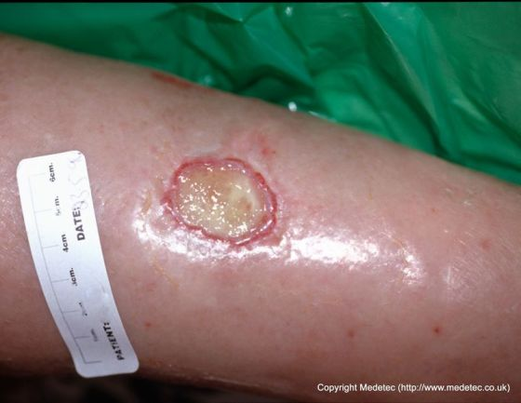
Case Example
56 year old female with history of varicose veins, HTN, Hyperlipidemia, Obesity.
Presents to clinic with a wound to her right medial lower leg.
Client reports that she was out gardening and a branch scratched her leg
Wound is one week old
Signs and Symptoms?
Interventions?

Slide 27
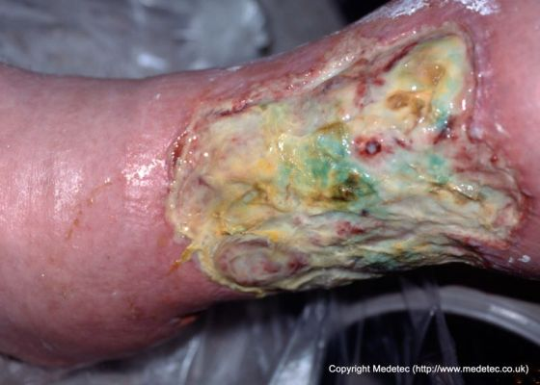
Follow up 4 weeks later
Referred to Community nursing clinic: put a foam dressing on the wound twice a week and advised patient not to shower
At her follow up appointment you notice the following:
Signs and Symptoms?
What went wrong?

Slide 29
References
Dow, G. et al. 1999. Infection in chronic wounds: controversies in diagnosis and treatment. Ostomy Wound Management 45, pp. 46-62.
International Wound Infection Institute. 2016. Wound infection in clinical practice. Wounds International.
Lipsky, B.A. et al. 2012. 2012 Infectious diseases society of America clinical practice guideline for the diagnosis and treatment of diabetic foot infections. Clinical Infectious Diseases 54(12), pp. 132-173.
Sibbald, R.G. 2011. Special considerations in wound bed preparation 2011: an update. Advances in Skin Wound Care 24, pp 415-436.
Woo, K.Y. and Sibbald, R.G. 2009. A cross-sectional validation study of using NERDS and STONEES to assess bacterial burden. Ostomy Wound Management 55(8), pp. 40-48.

